Slide 1
Measuring limb volume from six phone photos
A reworked VGGT pipeline — what changed, what it is worth, and one conclusion that was wrong
Senior project · progress meeting · 24 August 2026

Slide 2
THE PROBLEM
Six phone photos in, a volume in cm³ out
• Input: 6 to 12 photographs of a limb standing beside a 14 cm ArUco cube.
• VGGT reconstructs the scene as a point cloud. The cube is the only thing in the frame whose size is known, so it supplies the real-world scale — 2744 cm³ by construction, 14³.
• The limb is segmented, the ghost surface removed, the cut plane found at the marker band, and the survivor turned into a closed mesh.
• Output: the volume that mesh encloses, integrated exactly — and a statement of whether it is one closed solid, so the number can be trusted or refused.
Seven stages. Two of them stop and wait for a person: the framing verdict, and the cut plane.

Slide 3
WHERE IT STARTED
Before — six stages, nothing checked the input
• The photographs went straight to VGGT, which centre-crops them itself.
• One reconstruction method, one fixed set of thresholds, no way to intervene.
• The reference mesh never closed, so its volume was estimated by flooding a voxel grid — an approximation with no error signal when it leaks.
One pass, start to finish, with nothing between the photographs and a number.

Slide 4
WHERE IT IS NOW
After — seven stages, two can stop the run
• Stage 0 is new: it judges the capture before a GPU is touched.
• Stage 3 measures the marker's colour from the capture instead of assuming it, and the cut waits for a human to confirm the plane.
• Stage 4 chooses its method and Stage 5 proves the result is one closed solid — if it is not, Stage 4 is re-run with a method that cannot fail to close.
Every stage writes its own directory, so any one of them can be re-run without repeating the rest.

Slide 5
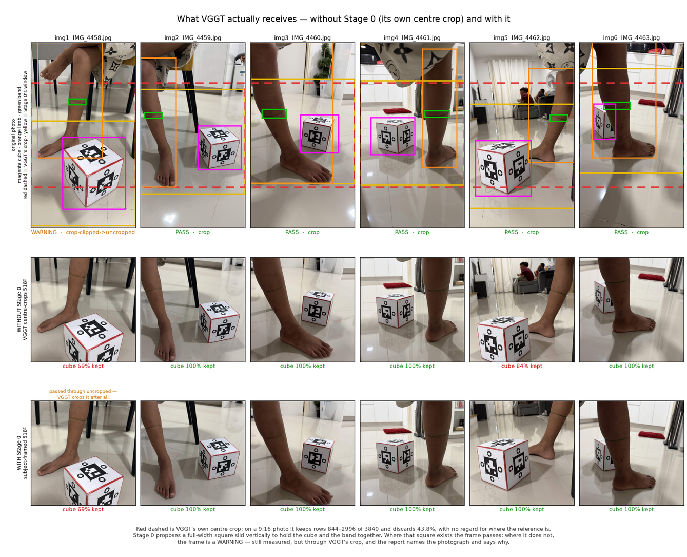
STAGE 0 · FRAMING GATE
A capture can now be refused before any of it is measured
• VGGT crops a 9:16 photo to a square and discards 43.8% of it, with no regard for where the reference cube is.
• On IMG_4462 that cuts 16% off the cube — and the cube sets the scale for every number the run reports. A truncated cube still reconstructs; it just reconstructs smaller.
• Stage 0 places its own window: 100% of the cube on all five frames it can crop.
• Three verdicts. IMG_4458 is a warning, not a rejection — a square holding the cube exists, but none holds the cube and the band together, so the frame is measured through VGGT's crop and the report says so.

Slide 6
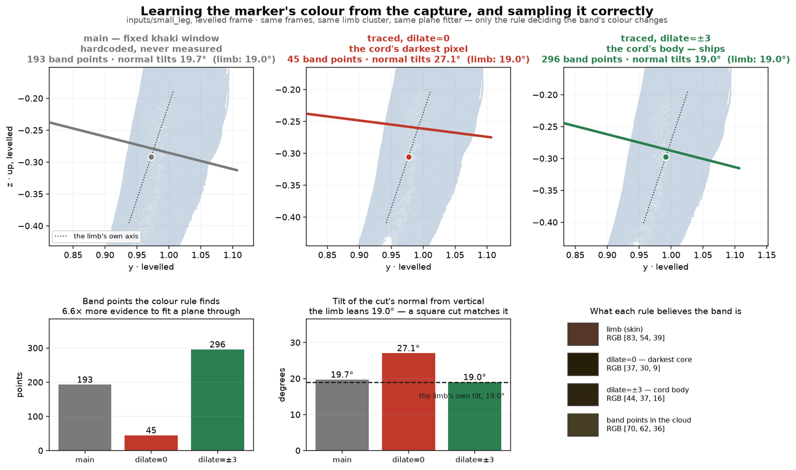
STAGE 3 · WHERE TO CUT
The marker's colour is measured, not assumed
• main used a hardcoded khaki window that never looked at the photographs.
• Tracing only the cord's darkest pixel finds 45 points, and the cut it fits tilts 27.1° from vertical.
• Dilating the trace by ±3 px finds 296 — 6.6× more evidence — and the cut tilts 19.0°, matching the limb's own 19.0° lean.
• The cut plane sets where the limb ends. A plane fitted to 45 points is the difference between measuring the calf and measuring part of the ankle.

Slide 7
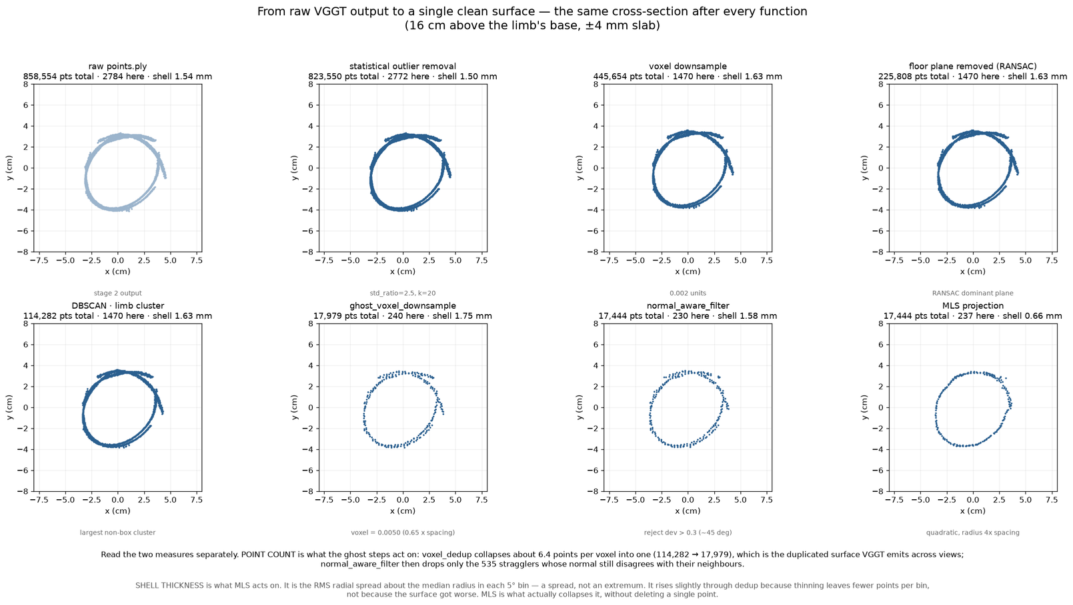
STAGE 3 · THE GHOST
VGGT emits the same surface more than once
• Each camera group registers the limb slightly differently, so the shell arrives about 2.7 mm thick instead of thin.
• Voxel downsampling collapses 6.4 points per voxel into one: 114,282 → 17,979 points. That ratio is the measurement of how duplicated the surface was.
• normal_aware_filter then removes only 535 stragglers — 2.9%.
• MLS deletes nothing at all and still halves the shell: 1.63 mm → 0.66 mm RMS.

Slide 8
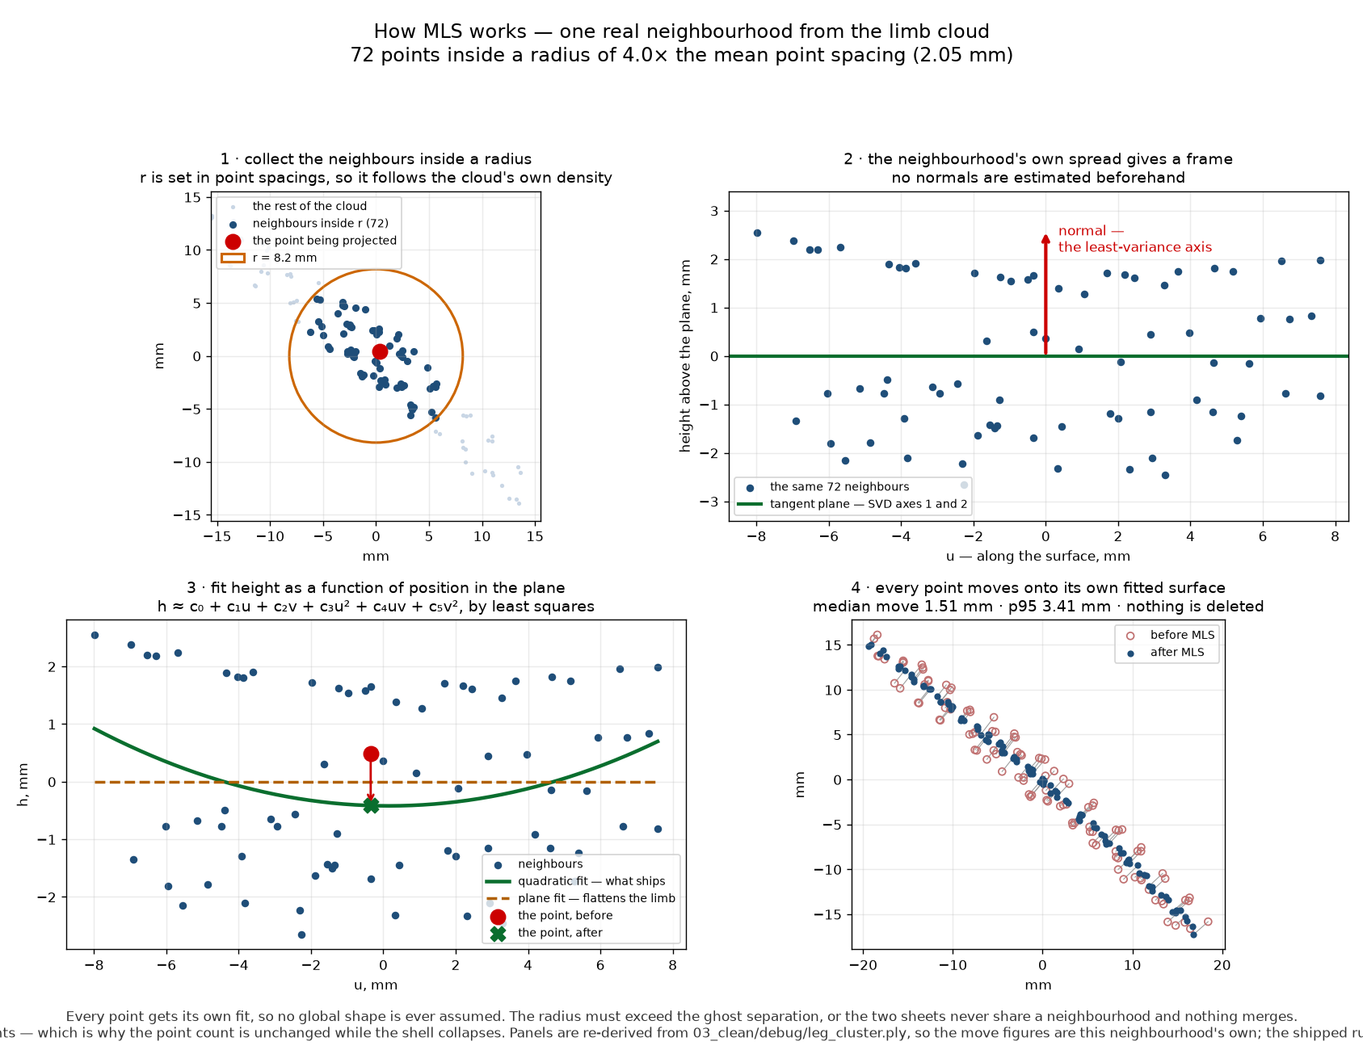
STAGE 3 · SMOOTHING
How MLS works, in four steps
Moving Least Squares. Each point is re-fitted against its own neighbours — collect them inside a radius, take a local frame from their spread, fit height as a curved function of position, and move the point onto that surface.

Slide 9
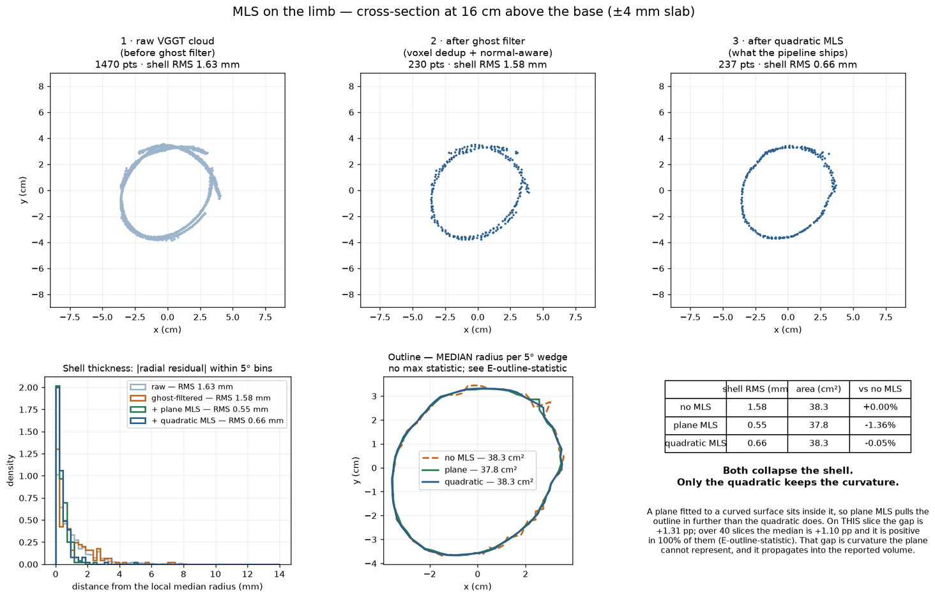
STAGE 3 · SMOOTHING
MLS has to be quadratic
• MLS projects each point onto a surface fitted to its neighbours. Fit a plane to a curved limb and the plane sits inside it, so the outline shrinks.
• On this slice: plane MLS loses 1.36% of the cross-section area, quadratic MLS 0.05%.
• Across 40 slices the gap is +1.10 pp and positive in 100% of them — not noise.
• Both collapse the shell equally well. Only the quadratic keeps the shape.

Slide 10
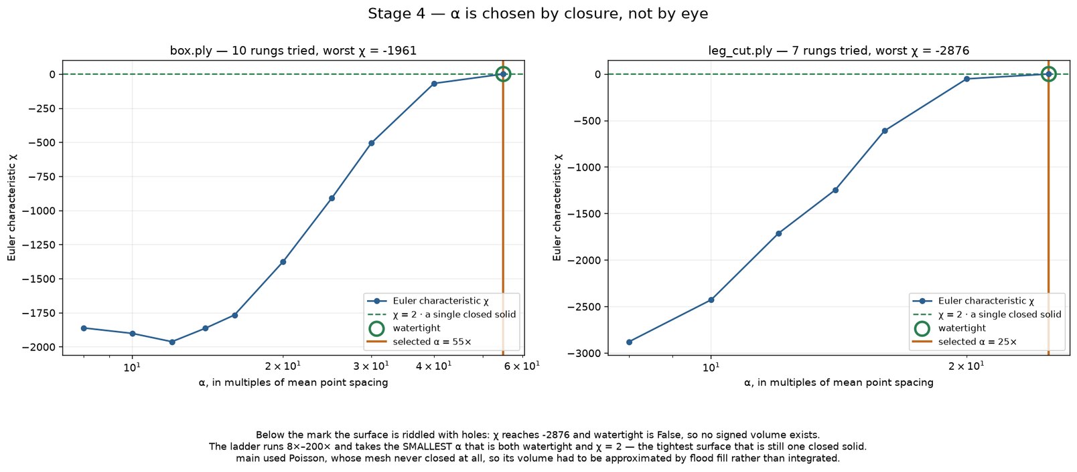
STAGE 4 · THE GUARANTEE
α is chosen by closure, not by eye
• The ladder runs α from 8× to 200× the mean point spacing and takes the smallest α that is watertight and has Euler characteristic χ = 2.
• χ = 2 − 2g, so χ = 2 means genus 0: one closed surface with no handles. It is the only case where 'the volume enclosed' is defined at all.
• Below the mark the surface is riddled with holes — χ reaches −2876 — and no signed volume exists.
• Because the ladder selects on χ, it cannot fail to produce χ = 2. That is exactly what makes alpha shape the fallback in the pipeline that ships.

Slide 11
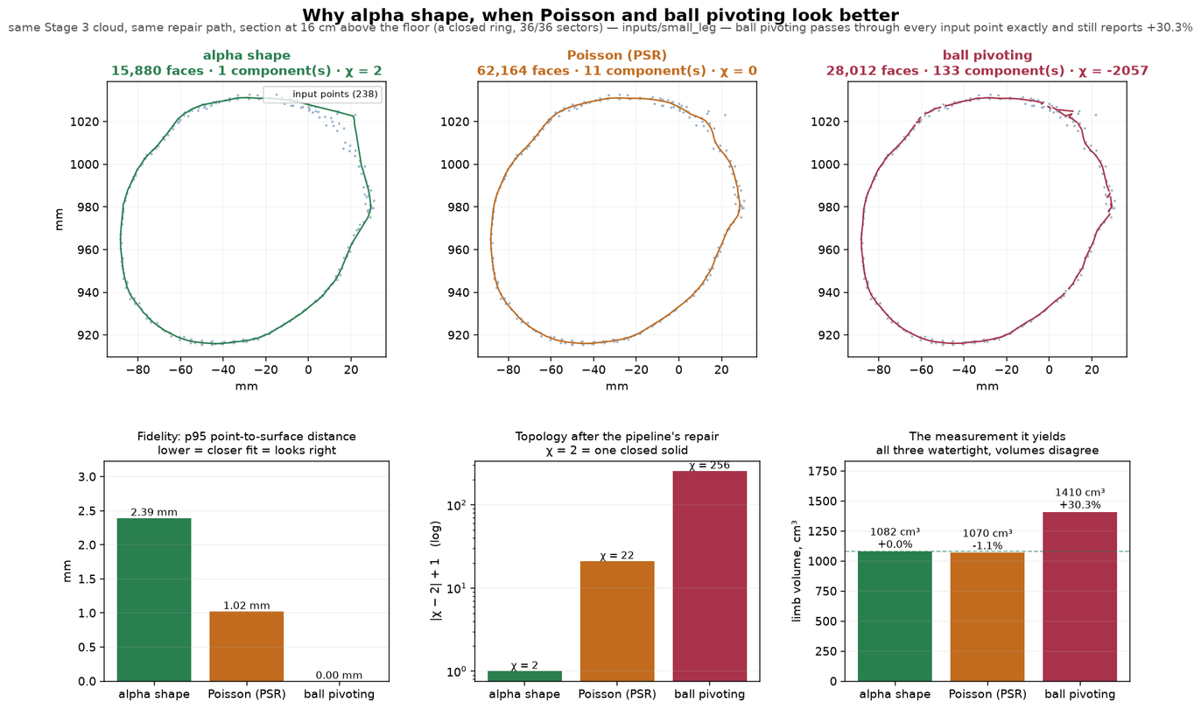
STAGE 4 · THE COMPARISON
Three methods, same points, wrong conclusion
• Ball pivoting interpolates every input point exactly — p95 distance 0.00 mm — and still reports +30.3%. Looking right is not being right.
• Poisson fitted the points closest (1.02 mm) but came out of the pipeline at χ = 0 with 11 components. So alpha shape was chosen.
• That conclusion was wrong, and it was wrong for a reason worth showing: the defect was not in Poisson.
The figure is exactly as it was measured. What it concludes no longer holds, and the next slide is why.

Slide 12
STAGE 5 · THE REPAIR STAGE
The stage meant to fix this was doing half its job
• workers/meshfix_worker.py called pymeshfix.fill_holes() and nothing else.
• fill_holes closes the boundary but leaves self-intersections and non-manifold edges — watertight, and still not a solid.
• repair() removes those too. Every Poisson mesh had been arriving at Stage 6 closed and topologically wrong, and Poisson was blamed for it.
• Cost of the fix to the reported volume: 0.005% — 1069.56 → 1069.61 cm³. Alpha-shape meshes are byte-identical either way; they arrive closed, so Stage 5 is a no-op on them.
χ after Stage 5 | fill_holes | repair()
small_leg · reference cube | 30 | 2
small_leg · limb | 22 | 2
short_leg · reference cube | 10 | 2
short_leg · limb (uncut, with foot) | 14 | −16
48-config sweep, χ = 2 on both | 0 of 48 | 38 of 46
The reported volume moves 0.005% when Stage 5 is fixed — 1069.56 to 1069.61 cm³. What changes is the topology, not the shape.

Slide 13
STAGE 4 · WHAT SHIPS NOW
Poisson everywhere, alpha shape as the fallback
• Poisson fits the points 1.8× closer on small_leg and 10× closer on short_leg.
• It is insensitive to its own parameters: twelve depth/trim combinations span 0.32% of limb volume. trim > 0 is required — every trim = 0 run gives χ = 4.
• What it costs, stated plainly: Poisson has no genus guarantee. On short_leg it closes at χ = −18, about ten handles, and reads 22% below the alpha answer.
• So Stage 5 now checks χ, and any object that does not reach 2 is reconstructed again with alpha shape. Verified firing on short_leg and not firing on small_leg.
small_leg | limb cm³ | box χ | limb χ | p95
alpha / alpha | 1081.94 | 2 | 2 | 2.39 mm
alpha cube + Poisson limb | 1070.85 | 2 | 2 | 1.30 mm
Poisson / Poisson ← ships | 1074.32 | 2 | 2 | 1.30 mm
short_leg · no cut
alpha / alpha | 2763.24 | 2 | 2 | 21.80 mm
Poisson / Poisson | 2146.39 | 2 | −18 | 2.19 mm
short_leg is the honest counter-example: no band means no cut, so the object is the whole foot — toes, arch, the gap under the instep. Genuine topology — and the reason the fallback exists.

Slide 14
RESULTS
Where the numbers stand, on inputs/small_leg
 | main | current
wall clock | 136.7 s | 80 s
capture validation | none | 5 pass, 1 warn, 0 reject
marker colour | hardcoded khaki | measured per capture
reference mesh watertight | no | yes, χ = 2
volume method | warp+floodfill | watertight — same code
limb volume, cm³ | 1073.98 (flooded) | 1074.32 (integrated)
• The reference cube reports exactly 2744.00 cm³ on every run. That is an identity, not an accuracy result: scale is derived as (real / mesh)^(1/3) from that same cube, so it can never disagree with itself.
• The watertight row is the one that matters. main's reference mesh never closes, so its volume cannot be integrated — it is flooded, and a flood leaks through any hole without saying so.
• The current tree searches until the mesh closes and χ = 2, then integrates the surface exactly.
• Stage 6 is main's code, byte for byte — 618 added lines, all comments. Its first tier was always the exact signed volume; main never reached it because its meshes were open. The improvement is upstream.
• The two limb figures agreeing to 0.03% is not evidence of anything: one is a flood fill of a mesh with holes, the other an exact integral. They are not the same measurement.

Slide 15
WHAT IS NOT KNOWN
The limits, stated before someone else states them
• There is no ground truth for the limb. Nothing in this deck is an accuracy measurement against a known volume.
• est_325's 325 ml is a fill volume, not external displacement, so it does not settle the error target either.
• Poisson has no genus guarantee, and short_leg shows what that looks like: χ = −18 on an uncut foot, where toes and the gap under the instep are genuine topological complexity rather than a defect.
• Both Poisson successes are the same capture. Whether it holds on a cut limb from a second capture is untested.
• Stage 0's two new thresholds — a band at most 0.35 of the limb, seen in at least 0.6 of the frames — have been tested on one banded capture only.
Next: a second banded capture, to test the fallback on a cut limb and the two Stage 0 thresholds on something other than the capture they were written for.

